Slide 1
Dentist
Database Project
hxh163730 Hsiao-Han Huang
jxd151630 Jianjun Du
wxw152030 Wen Chen Wu

Slide 2
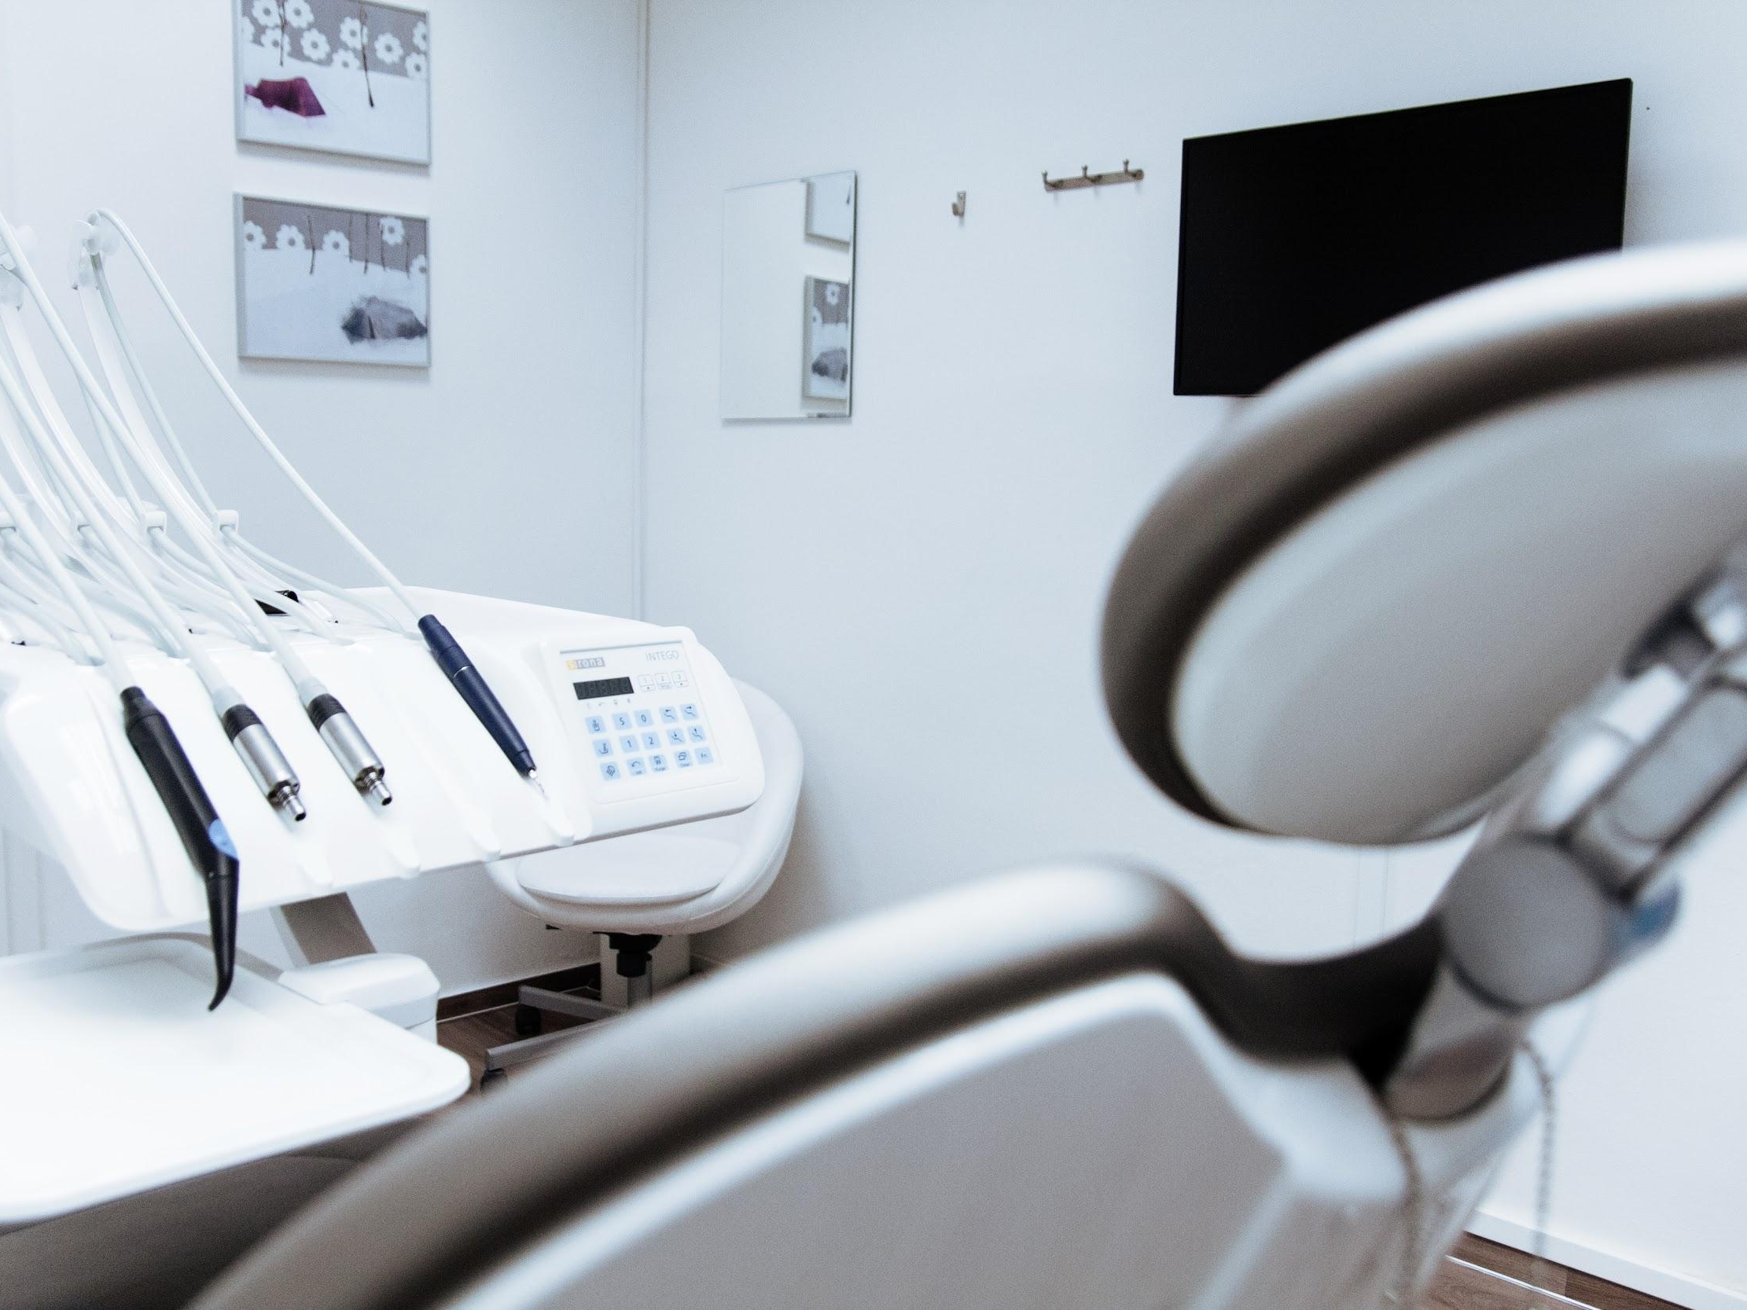
Introduction
We designed a database for a dental clinic.

Slide 3
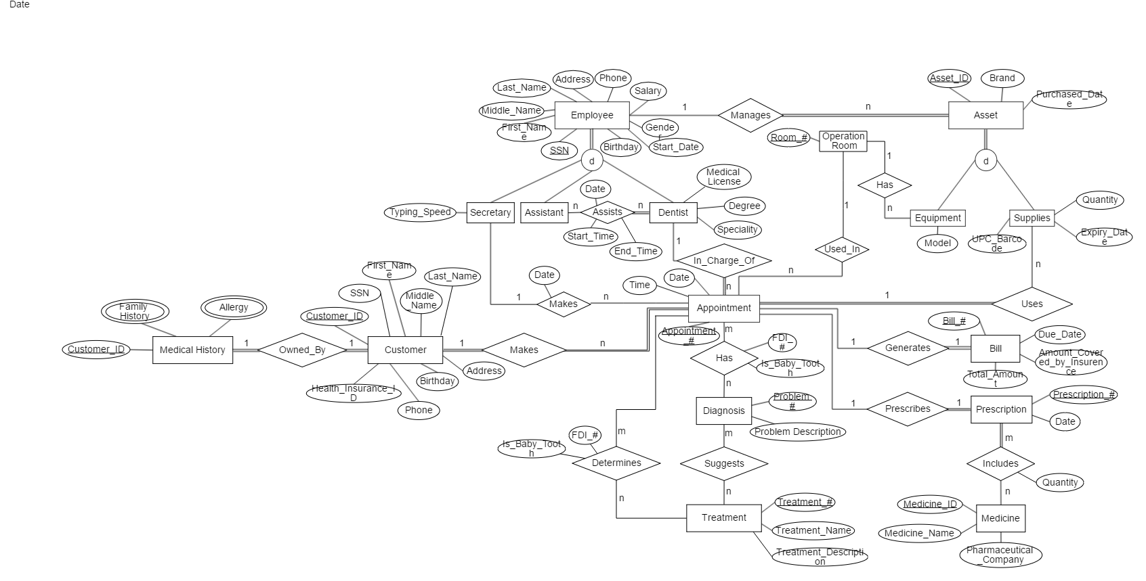
ER Diagram

Slide 4
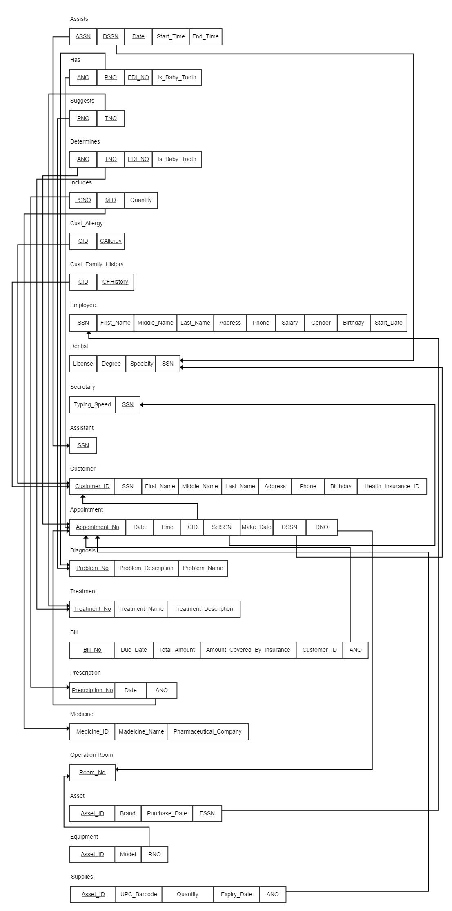
Relational Schema
Notes:
This schema is normalized into 3NF.

Slide 5
Data Requirements
Not all customers have a SSN, so we cannot use the SSN as the primary key.
We did not integrate Appointment and Visit into a single table because customers might not show up in an appointment. It is not possible to record the data of the customers if we only have a single table.
EMPLOYEE
Customer_ID | SSN | First_Name | Middle_Name | Last_Name | Address | Phone | Birthday | Health_Insurance_ID

Slide 6
Data Requirements (Cont.)
Customers might not necessarily have a treatment when they visit the clinic, they might start the treatment in their future return visit. So we divide the table into Treatment, Diagnosis, and Visit.
TREATMENT
DIAGNOSIS
Treatment_No | Treatment_Name | Treatment_Description
Problem_No | Problem_Description | Problem_Name
VISIT
Problem_No | Problem_Description | Problem_Name

Slide 7
Data Requirements (Cont.)
What if the patient is referred to another dentist? No problem will occur since we will create a new appointment that is associated with another doctor.
A Customer must be admitted.

Slide 8
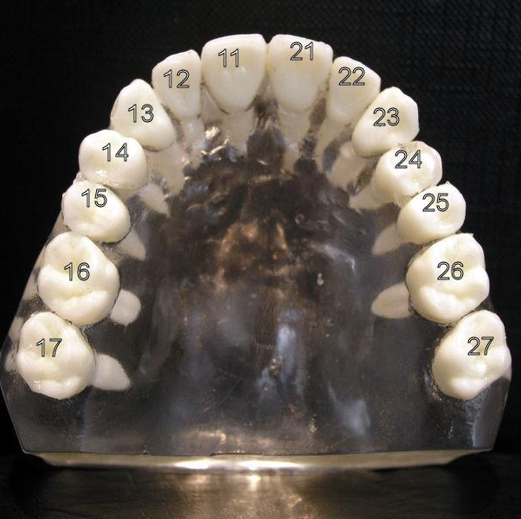
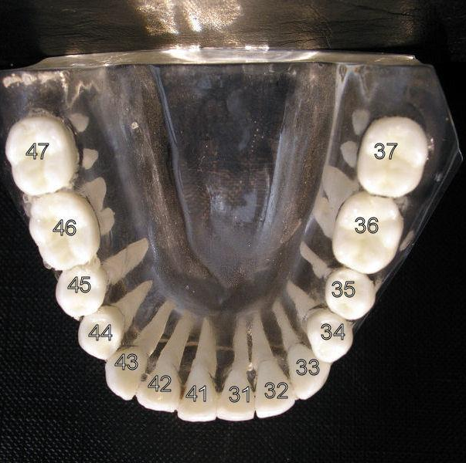
FDI Dental Notation (ISO 3950)
FDI World Dental Federation notation is widely used by dentists internationally to associate information to a specific tooth.
The figures display the upper and lower jaw.

Slide 9

ICD-10
ICD-10 is the 10th revision of the International Statistical Classification of Diseases and Related Health Problems (ICD), a medical classification list by the World Health Organization (WHO).
It contains codes for diseases, signs and symptoms, abnormal findings, complaints, social circumstances, and external causes of injury or diseases.

Slide 10
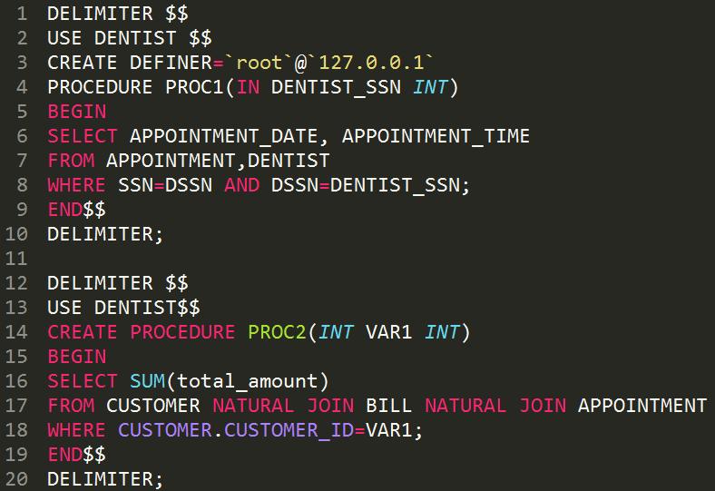
Procedure
Notes:
The first procedure is used to find all appointment made to a dentist
The second procedure is to find out the total amount of bills a customer owns

Slide 11
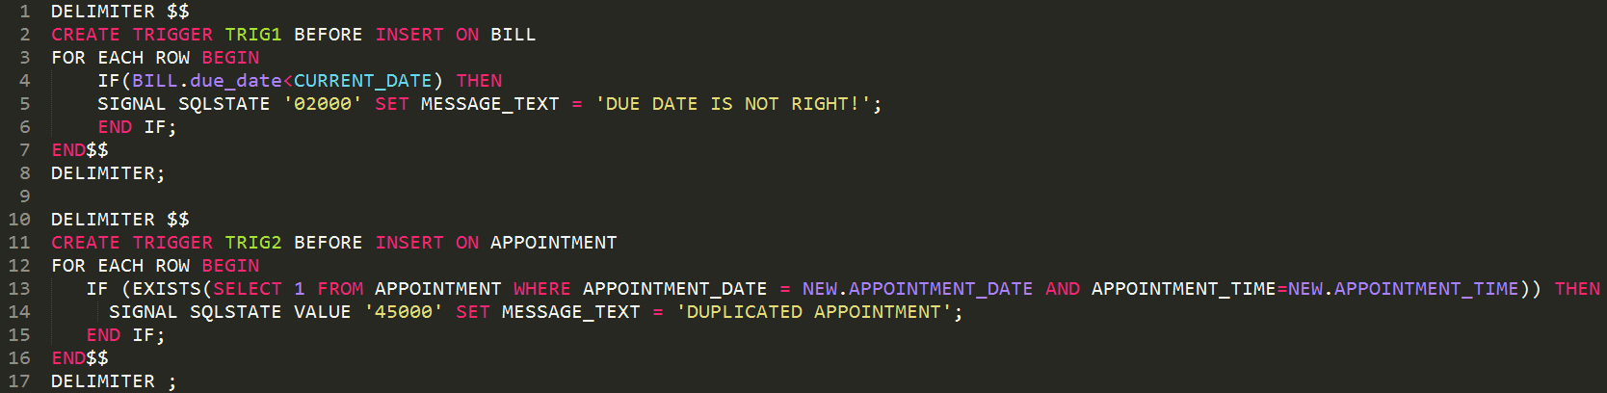
Trigger
Notes:
The 1st trigger is used to check if the due_date already passed the current date.
The 2nd trigger is used to check if there is a same appointment existing in the table.

Slide 12
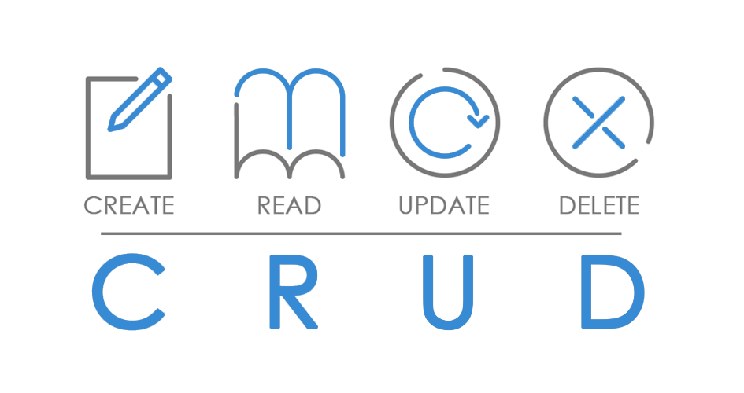
CRUD Operations

Slide 13
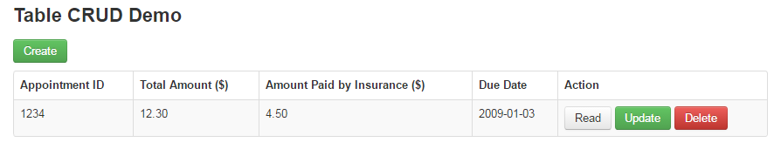
Main Webpage

Slide 14
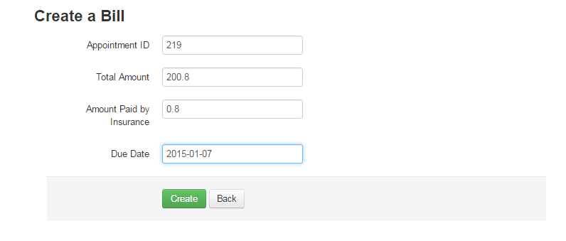
Create

Slide 15
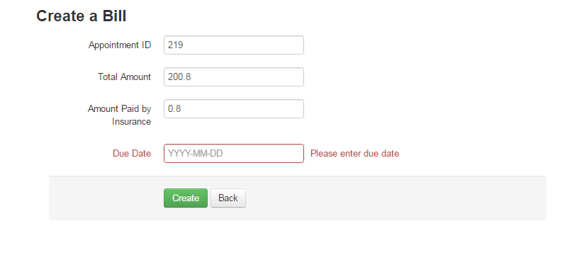
Create (Missing Fields Error Message)

Slide 16
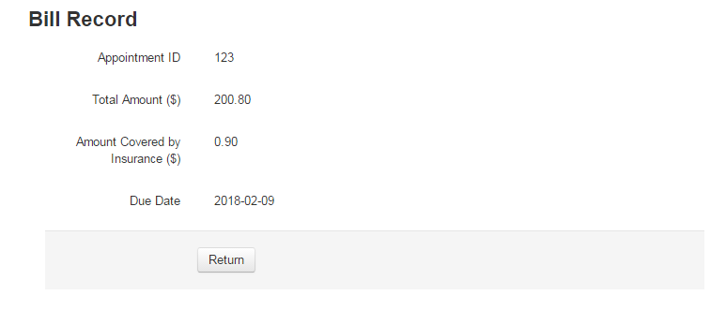
Read

Slide 17
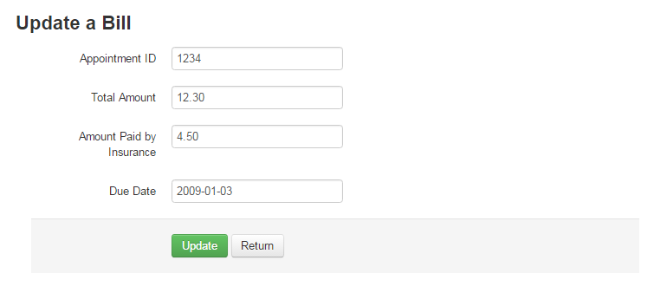
Update

Slide 18
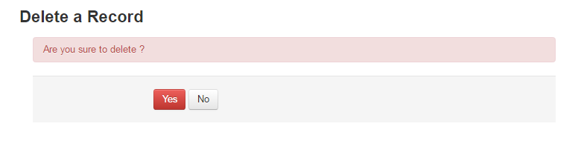
Delete

Slide 19
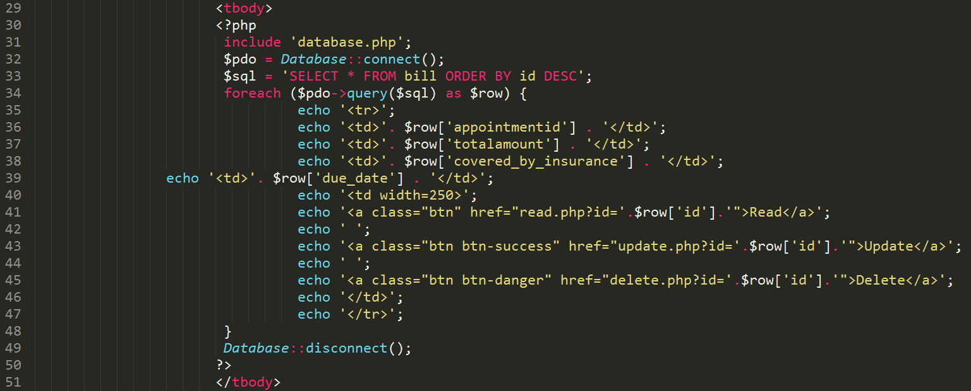
Problems Encountered & Troublshooting
Notes:
It is case sensitive in PHP, although it is not in MySQL.

Slide 20
Q & A

